Slide 1
Time Series Analysis, Properties and Prediction Models
Dr. Mayank Agarwal (IIT Patna)

Slide 2
Objectives of time series analysis
Data description
Data interpretation
Modeling
Control
Prediction & Forecasting

Slide 3
Time-Series Data
Numerical data obtained at regular time intervals
The time intervals can be annually, quarterly, monthly, weekly, daily, hourly, etc.
Example:
Year: 2005 2006 2007 2008 2009
Sales: 75.3 74.2 78.5 79.7 80.2

Slide 4
Time Plot
A time-series plot (time plot) is a two-dimensional plot of time series data
the vertical axis measures the variable of interest
the horizontal axis corresponds to the time periods

Slide 5
Time-Series Components
Time Series
Trend Component
Seasonal Component
Cyclical Component
Irregular /Random Component
Overall, persistent, long-term movement
Regular periodic fluctuations, usually within a 12-month period
Repeating swings or movements over more than one year
Erratic or residual fluctuations

Slide 6
Trend Component
Long-run increase or decrease over time (overall upward or downward movement)
Data taken over a long period of time
Sales
Upward trend
Time

Slide 7
Trend Component
(continued)
Trend can be upward or downward
Trend can be linear or non-linear
Sales
Sales
Time
Time
Downward linear trend
Upward nonlinear trend

Slide 8
Seasonal Component
Short-term regular wave-like patterns
Observed within 1 year
Often monthly or quarterly
Sales
Summer
Winter
Summer
Winter
Spring
Fall
Spring
Fall
Time (Quarterly)

Slide 9
Cyclical Component
Long-term wave-like patterns
Regularly occur but may vary in length
Often measured peak to peak or trough to trough
1 Cycle
Sales
Year

Slide 10
Irregular/Random Component
Unpredictable, random, “residual” fluctuations
“Noise” in the time series
The truly irregular component may not be estimated – however, the more predictable random component can be estimated – and is usually the emphasis of time series analysis via the usual stationary time series models such as AR, MA, ARMA etc after we filter out the trend, seasonal and other cyclical components

Slide 11
Two simplified time series models
In the following, we present two classes of simplified time series models
Non-seasonal Model with Trend
Classical Decomposition Model with Trend and Seasonal Components
The usual procedure is to first filter out the trend and seasonal component – then fit the random component with a stationary time series model to capture the correlation structure in the time series
If necessary, the entire time series (with seasonal, trend, and random components) can be re-analyzed for better estimation, modeling and prediction.

Slide 12
Non-seasonal Models with Trend
X_{t} = m_{t} + Y_{t}
Stochastic process
trend
random noise

Slide 13
Classical Decomposition Model with Trend and Season
X_{t} = m_{t} + s_{t} + Y_{t}
seasonal component
random noise
Stochastic process
trend

Slide 14
Non-seasonal Models with Trend
There are two basic methods for estimating/eliminating trend:
Method 1: Trend estimation
(first we estimate the trend either by
moving average smoothing or regression analysis – then we remove it)
Method 2: Trend elimination by differencing

Slide 15

Method 1: Trend Estimation by Regression Analysis
Estimate a trend line using regression analysis
Use time (t) as the independent variable:
Year | Time Period (t) | Sales (X)
2004 2005 2006 2007 2008 2009 | 0 1 2 3 4 5 | 20 40 30 50 70 65
In least squares linear, non-linear, and
exponential modeling, time periods are
numbered starting with 0 and increasing
by 1 for each time period.

Slide 16

Least Squares Regression
Without knowing the exact time series random error correlation structure, one often resorts to the ordinary least squares regression method, not optimal but practical.
The estimated linear trend equation is:
Year | Time Period (t) | Sales (X)
2004 2005 2006 2007 2008 2009 | 0 1 2 3 4 5 | 20 40 30 50 70 65

Slide 17
Linear Trend Forecasting
One can even performs trend forecasting at this point – but bear in mind that the forecasting may not be optimal.
Forecast for time period 6 (2010):
Year | Time Period (t) | Sales (X)
2004 2005 2006 2007 2008 2009 2010 | 0 1 2 3 4 5 6 | 20 40 30 50 70 65 ??

Slide 18
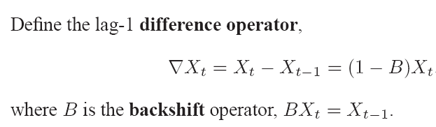

Method 2: Trend Elimination by Differencing

Slide 19


Trend Elimination by Differencing
If the operator ∇ is applied to a linear trend function:
Then we obtain the constant function:
In the same way any polynomial trend of degree k can be removed by the operator:

Slide 20
Classical Decomposition Model (Seasonal Model) with trend and season
where

Slide 21
Classical Decomposition Model
Method 1: Filtering: First we estimate and remove the trend component by using moving average method; then we estimate and remove the seasonal component by using suitable periodic averages.
Method 2: Differencing: First we remove the seasonal component by differencing. We then remove the trend by differencing as well.
Method 3: Joint-fit method: Alternatively, we can fit a combined polynomial linear regression and harmonic functions to estimate and then remove the trend and seasonal component simultaneously as the following:

Slide 22



Method 1: Filtering
(1). We first estimate the trend by the moving average:
If d = 2q (even), we use:
If d = 2q+1 (odd), we use:
(2). Then we estimate the seasonal component by using the average
, k = 1, …, d, of the de-trended data:
To ensure:
we further subtract the mean of
(3). One can also re-analyze the trend from the de-seasonalized data in order to obtain a polynomial linear regression equation for modeling and prediction purposes.

Slide 23



Method 2: Differencing
Define the lag-d differencing operator
as:
We can transform a seasonal model to a non-seasonal model:
Differencing method can then be further applied to
eliminate the trend component.

Slide 24
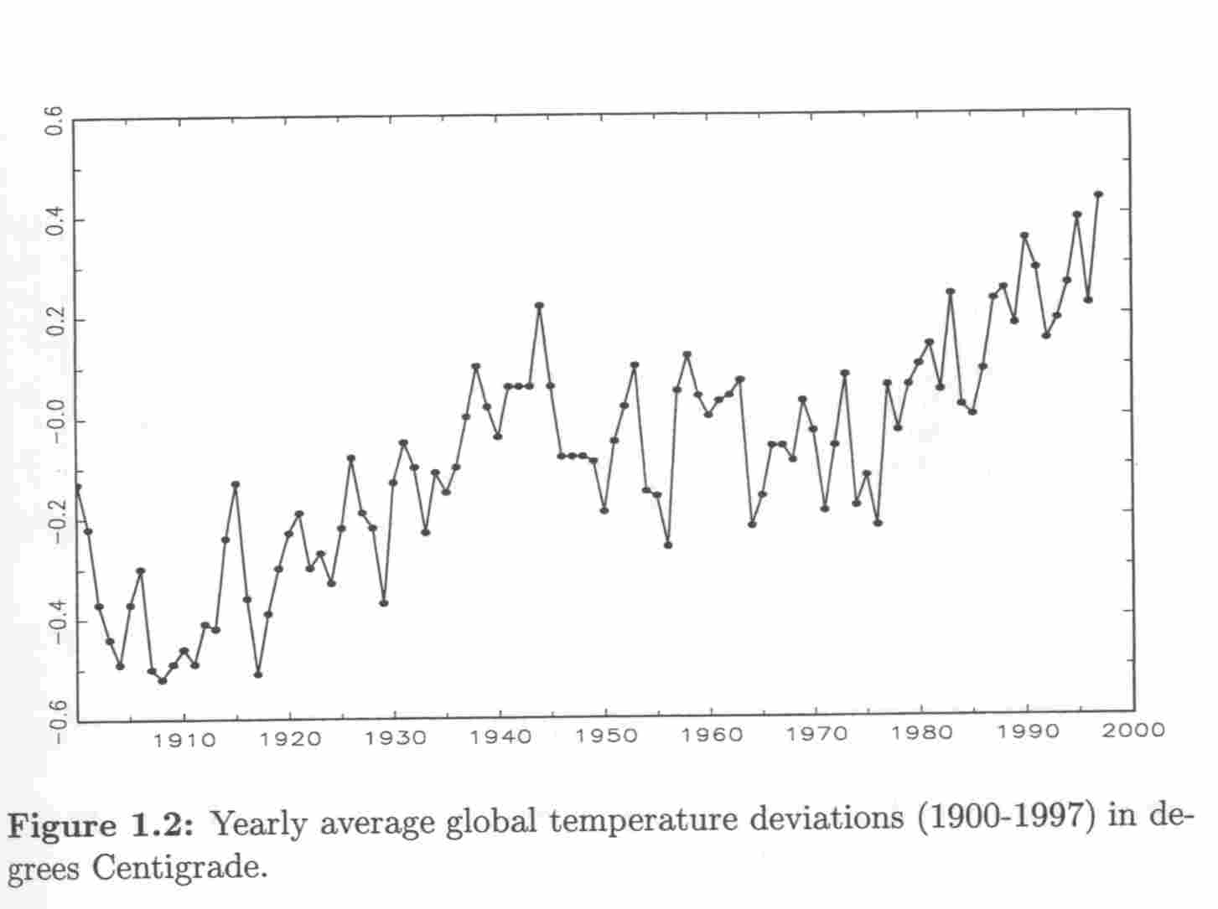
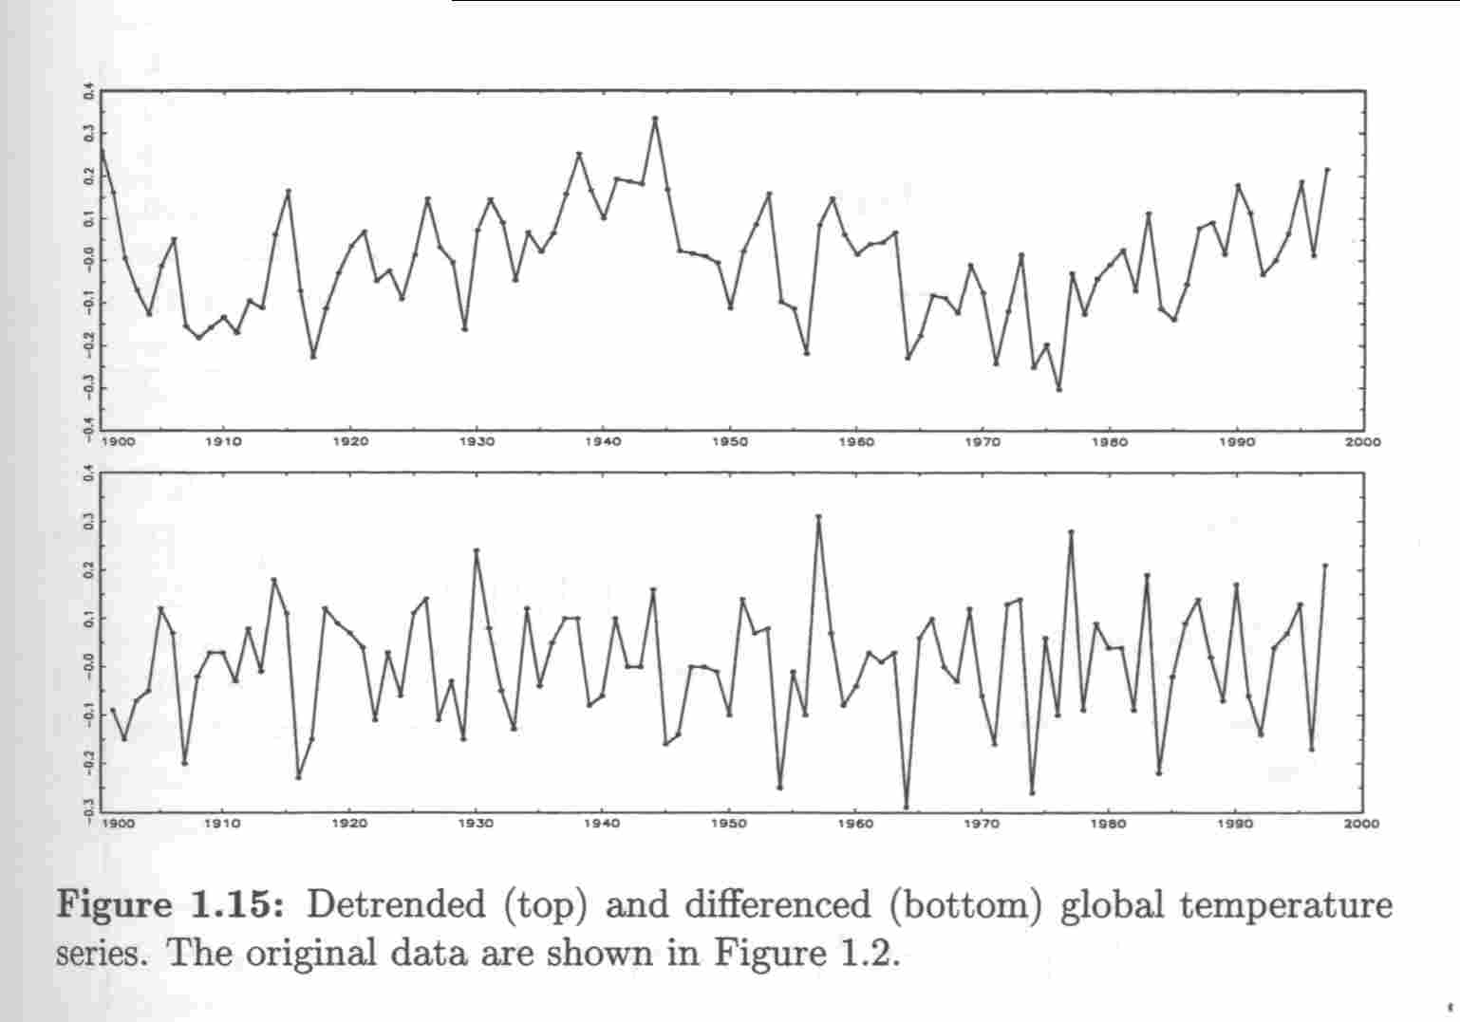
Detrended series
P. J. Brockwell, R. A. Davis, Introduction to Time Series and Forecasting, Springer, 1987

Slide 25
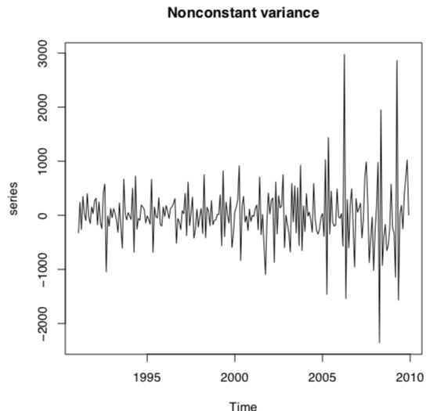
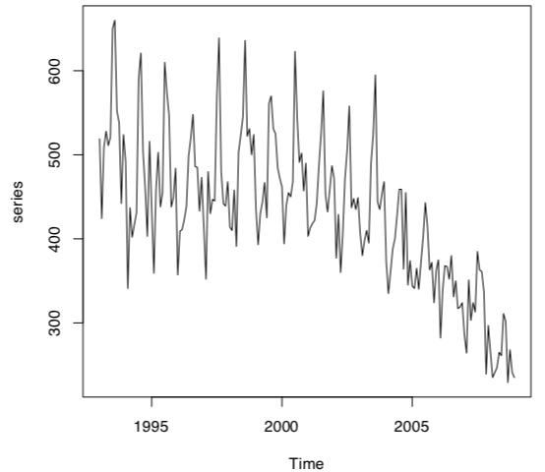
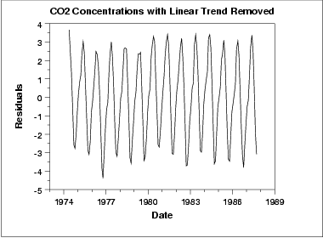
Stationarity of time series
Non Constant Variance
Conditions of stationarity:
Constant mean for all time steps.
Constant variance for all time steps.
The autocovariance function between X_{t1} and X_{t2} only depends on the interval t1 and t2.
Tests for Stationarity:
Augmented Dickey-Fuller test
KPSS test
Non Constant Mean
SRC: R Cran Package TS Tutorial
Stationary Time Series

Slide 26
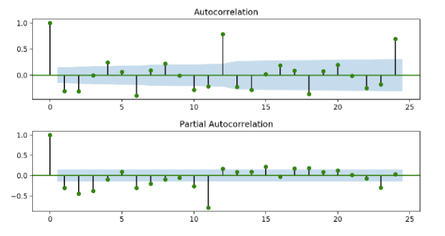
ACF and PACF
Autocorrelation Function:
The correlation of a variable with lagged value of itself.
When a variable is linearly dependent on its own past value.
Partial Autocorrelation Function:
The correlation of a variable with lagged value of itself taking into consideration the relationships of these terms with other lagged values.
Src: https://arauto.readthedocs.io/en/latest/how_to_choose_terms.html

Slide 27
Hands on Sessions
ARIMA and SARIMA model
Prophet Model
Deep Learning Models like LSTM and N-BEATS

Slide 28
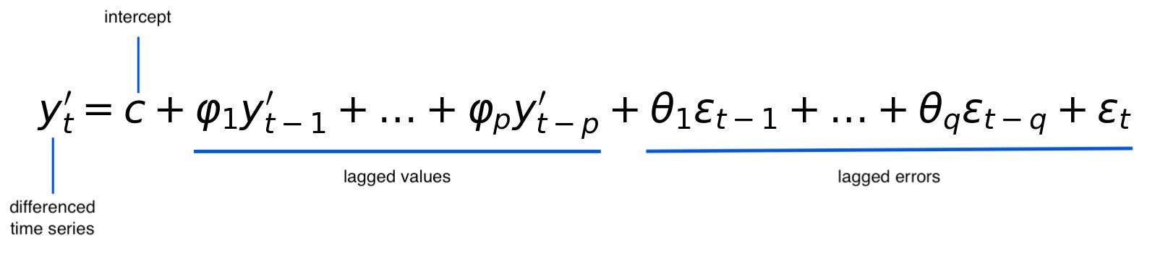
ARIMA and SARIMA Models
ARIMA(p,d,q) Model:
SARIMA(p,d,q)(P,D,Q) Model:
If we can identify a seasonal component in time series then we can use SARIMA.
P, D, Q are analogous to p, d, q but are terms used for the seasonal component.
Complex Mathematical equation.

Slide 29
How to choose parameters?
One way is to use ACF and PACF.
Other is we can use a grid search and try to minimize AIC and BIC.
Akaike information criterion = 2K - 2(LL)
Log-likelihood = log(RSS/N)
K = number of model parameters.
Bayes information criterion = -2 * LL + log(N) * K
Log-likelihood = log(RSS/n)
K = number of model parameters.
N = Number of training examples

Slide 30
Demo of ARIMA and SARIMA
Link: bit.ly/pydata-patna-arima

Slide 31
fbprophet Models
Developed by Facebook.
Very fast and easy to use.
An additive regression model where non-linear trends are fit with yearly, weekly, and daily seasonality, plus holiday effects.
Eq: y(t) = g(t) + s(t) + h(t) + ε_{t}
g(t): piecewise linear or logistic growth curve for trend
s(t): periodic changes
h(t): effects of holidays
ε_{t}: Residual term

Slide 32
Demo of Prophet Model
Link: bit.ly/pydata-patna-prophet

Slide 33
Deep Learning Models
When a time series has complex non-linear relations.
Neural Networks can map complex relations with ease.
NN are good at pattern recognition and can map deep relationships like human brain.
Commonly used deep learning architectures in time series:
RNN
GRU
CNN
LSTM
N-BEATS

Slide 34
Demo of Deep Learning
Link: bit.ly/pydata-patna-dl

Slide 35
Recap
What is time series?
What is time series forecasting?
Why time series forecasting is needed.
Basic concepts of time series like ACF, PACF, Stationarity, Seasonality, etc.
Some widely used time series models like:
ARIMA and SARIMA
Prophet Model
LSTM and N-BEATS

Slide 36
Reference
Box, George and Jenkins, Gwilym (1970) Time series analysis: Forecasting and control, San Francisco: Holden-Day.
Brockwell, Peter J. and Davis, Richard A. (1991). Time Series: Theory and Methods. Springer-Verlag.
Brockwell, Peter J. and Davis, Richard A. (1987, 2002).
Introduction to Time Series and Forecasting. Springer.
We also thank various on-line open resources for time series analysis.

